Slide 1

AERODROP
A SMART DRONE SYSTEM FOR MEDICAL AND ESSENTIALS
SIR C R REDDY COLLEGE OF ENGINEERING
(AUTONOMOUS)
DEPARTMENT OF ELECTRONICS AND COMMUNICATION ENGINEERING
BATCH-10
Presented by
23B85A0420 - U.S.V Ajay
23B85A0419 - T. Pavani
22B81A04G5 - Shaik Sadhiq
22B81A04G0 - S.Venkata Srikanth
22B81A04H0 - T. Sai Ganesh
Under the Guidance of
Mr A.M Vamsi Krishna M.Tech (Ph.D)
Assistant Professor
Department of ECE

Slide 2
ABSTRACT
This project develops an autonomous drone for delivering medicines to remote and hard-to-reach areas.
The drone carries lightweight medical supplies securely, using GPS navigation and basic flight control and a protected payload compartment ensures medicine safety.
It features vertical takeoff and landing, requiring no runways, making it adaptable to diverse environments.
Key components include a GPS module, flight controller, motors, battery, and medicine container.
The system addresses challenges like poor roads, traffic, and inaccessible regions. Designed for student-level implementation, it focuses on essential autonomous flight and delivery without complex navigation.
This provides a practical healthcare solution by improving access to medicines in underserved areas.
Keywords
Medicine Delivery, Autonomous Drone, GPS (Global Positioning System) Navigation, Healthcare Logistics, UAV (Unmanned Aerial Vehicle), Emergency Response, Remote Delivery

Slide 3
CONTENTS
  Introduction
  Problem Statement
  Objectives
  Literature Survey
  Existing Methodology
  Limitations of existing method
  Simulation results
  Proposed Methodology
  Future Scope
  Advantages
  Applications
  References

Slide 4
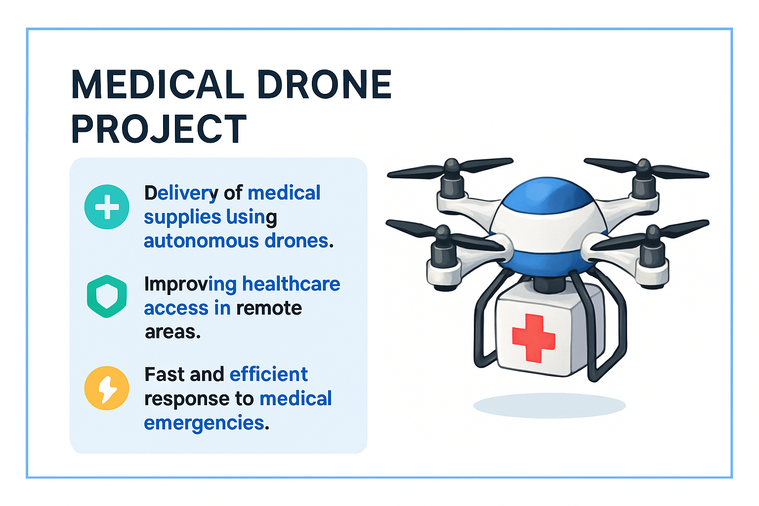
INTRODUCTION
Getting medicines on time is difficult in remote or rural areas because of bad roads, traffic, and other problems. In emergencies, traditional delivery is often too slow.
Drones can solve this by using GPS and flight control to deliver medicines quickly to hard-to-reach places.
They save time, avoid obstacles, reduce risks during pandemics, and help doctors reach patients faster.
Our project shows the design of an easy-to-build autonomous drone for medicine delivery.
It has a secure medicine box, GPS-based navigation, and vertical takeoff/landing to work in different areas without much infrastructure.
This system helps improve healthcare access and support patients in remote regions.

Slide 5
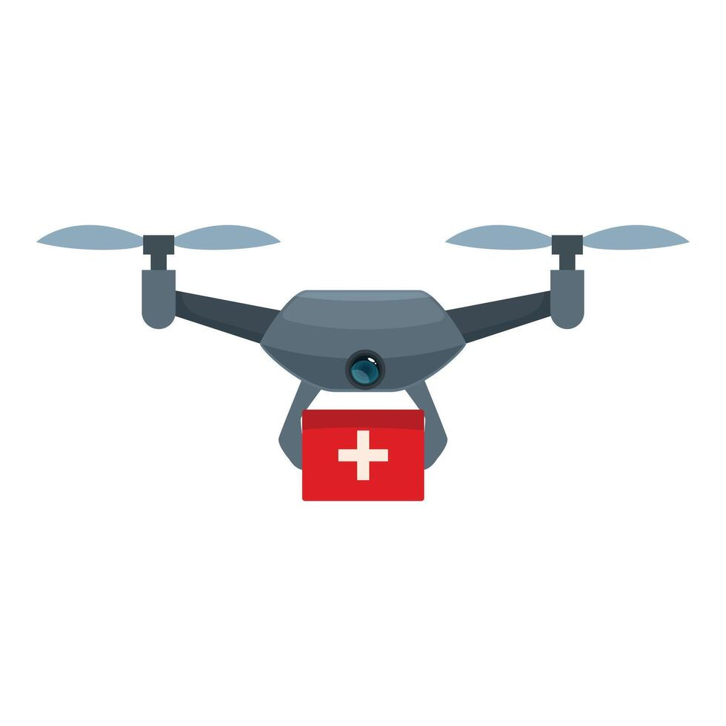
PROBLEM STATEMENT
Delivering medicine supplies to remote and underserved areas faces significant challenges including:
Limited Access to Remote Areas
Emergency Delays
Healthcare Disparities
Inadequate Delivery Systems
Risk of Disease Transmission

Slide 6
OBJECTIVES
Develop an autonomous drone to deliver medicines and essentials to hard-to-reach areas.
Use GPS and reliable control for safe, secure transport of lightweight medicine supplies.
Design the drone for vertical takeoff and landing, adaptable to various environments without special infrastructure.
Securely carry medical payloads, maintaining integrity during delivery.
Provide a practical, student-friendly UAV solution to improve healthcare access in underserved or remote regions.

Slide 7
LITERATURE SURVEY
Year | Author(s) | Focus Area | Key Findings & Contributions | Limitations | Application/Relevance
2015 | Ostojic et al. | Quadcopter Design and Control | Flight control algorithms and hardware design for quadcopters | Technical focus, limited healthcare application | Drone stability and control basis
2018 | Gunarathna & Munasinghe | Quadrotor-Fixed Wing Hybrid UAV Design | Combines quadrotor and fixed-wing capabilities for performance | Increased mechanical complexity | Extended flight times & payloads for drones
2019 | Konert et al. | Drones in Emergency Medicine | Explores practical and legal aspects for emergency drones | Evolving regulations | Foundational for integrating drones in EMS
2020 | Arya et al. | Drone Communication via LTE and 5G | LTE/5G networks enable improved drone connectivity | Infrastructure dependency | Real-time drone communication and tracking
2021 | Nyaaba & Ayamga | Medical Drones in African Healthcare | Identifies operational challenges in low-resource environments | Infrastructure, cost barriers | Insights into deploying drones in underserved areas
2022 | Dejene et al. | Medical Delivery Drones | Emphasizes logistic efficiency and cost-effectiveness | Focus on general logistics | Medical delivery during pandemics and emergencies

Slide 8
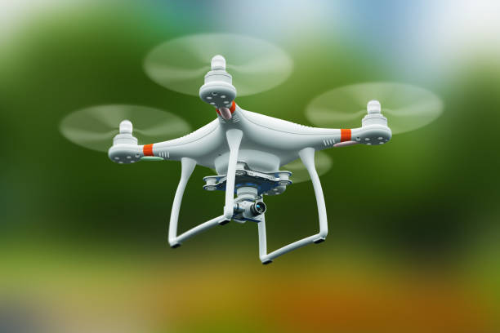
OVERVIEW OF CURRENT DRONE DELIVERY MODELS
Basic Drone Operation
Payload Management
Limited Navigation
Operational Constraints
Communication Setup
\

Slide 9
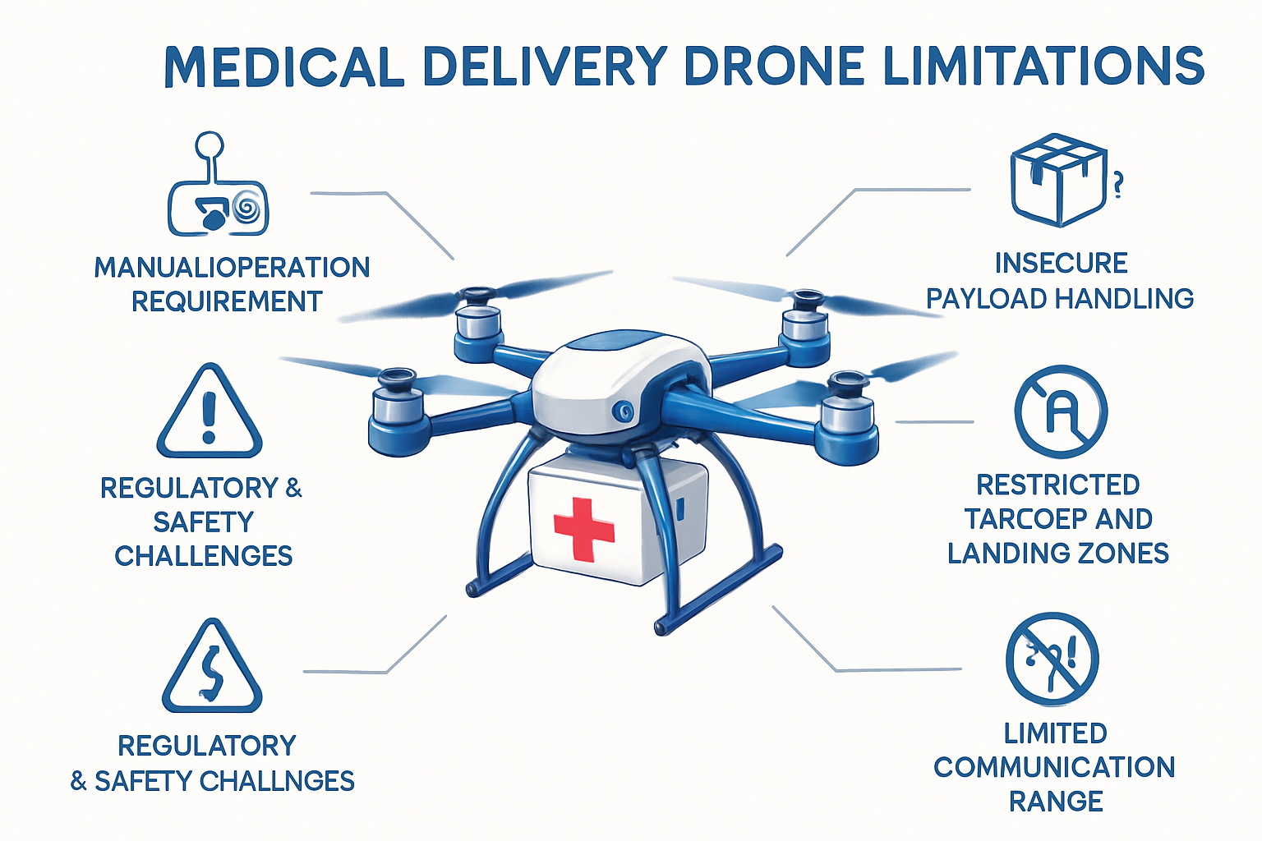


LIMITATIONS IN EXISTING DRONE
Manual or Semi-Autonomous Operation
Insecure Payload Handling
Navigation Limitations
Restricted Takeoff and Landing
Limited Communication and Control
High Cost and Complexity
Regulatory and Safety Challenges

Slide 10
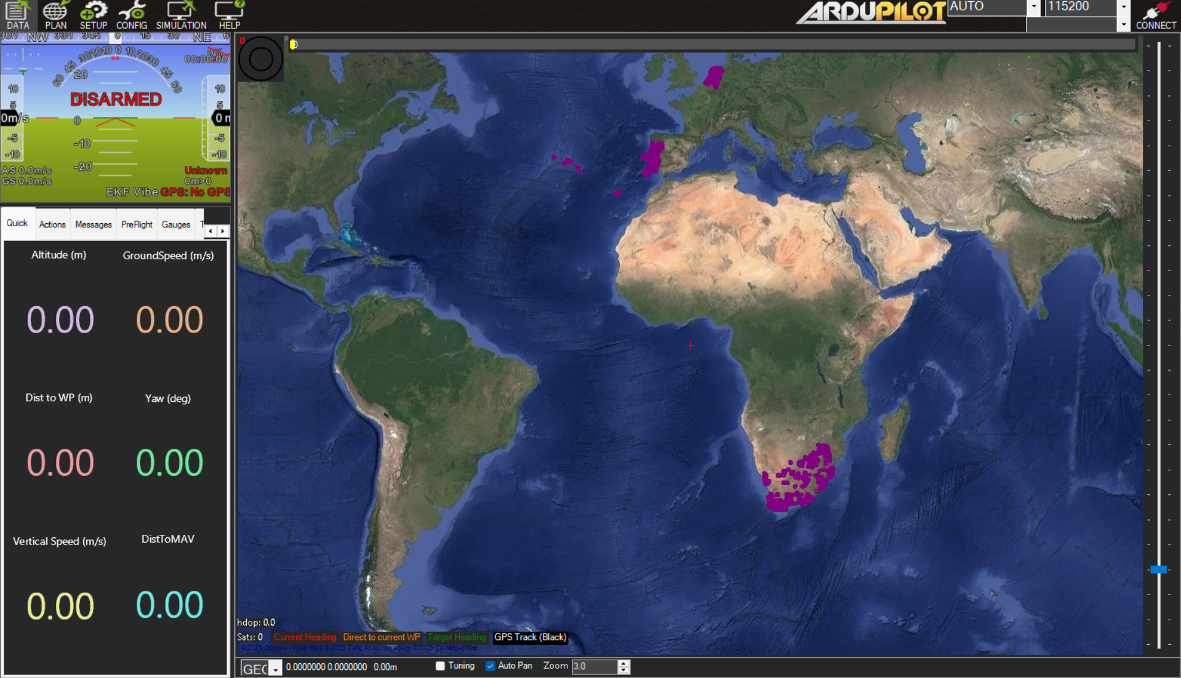
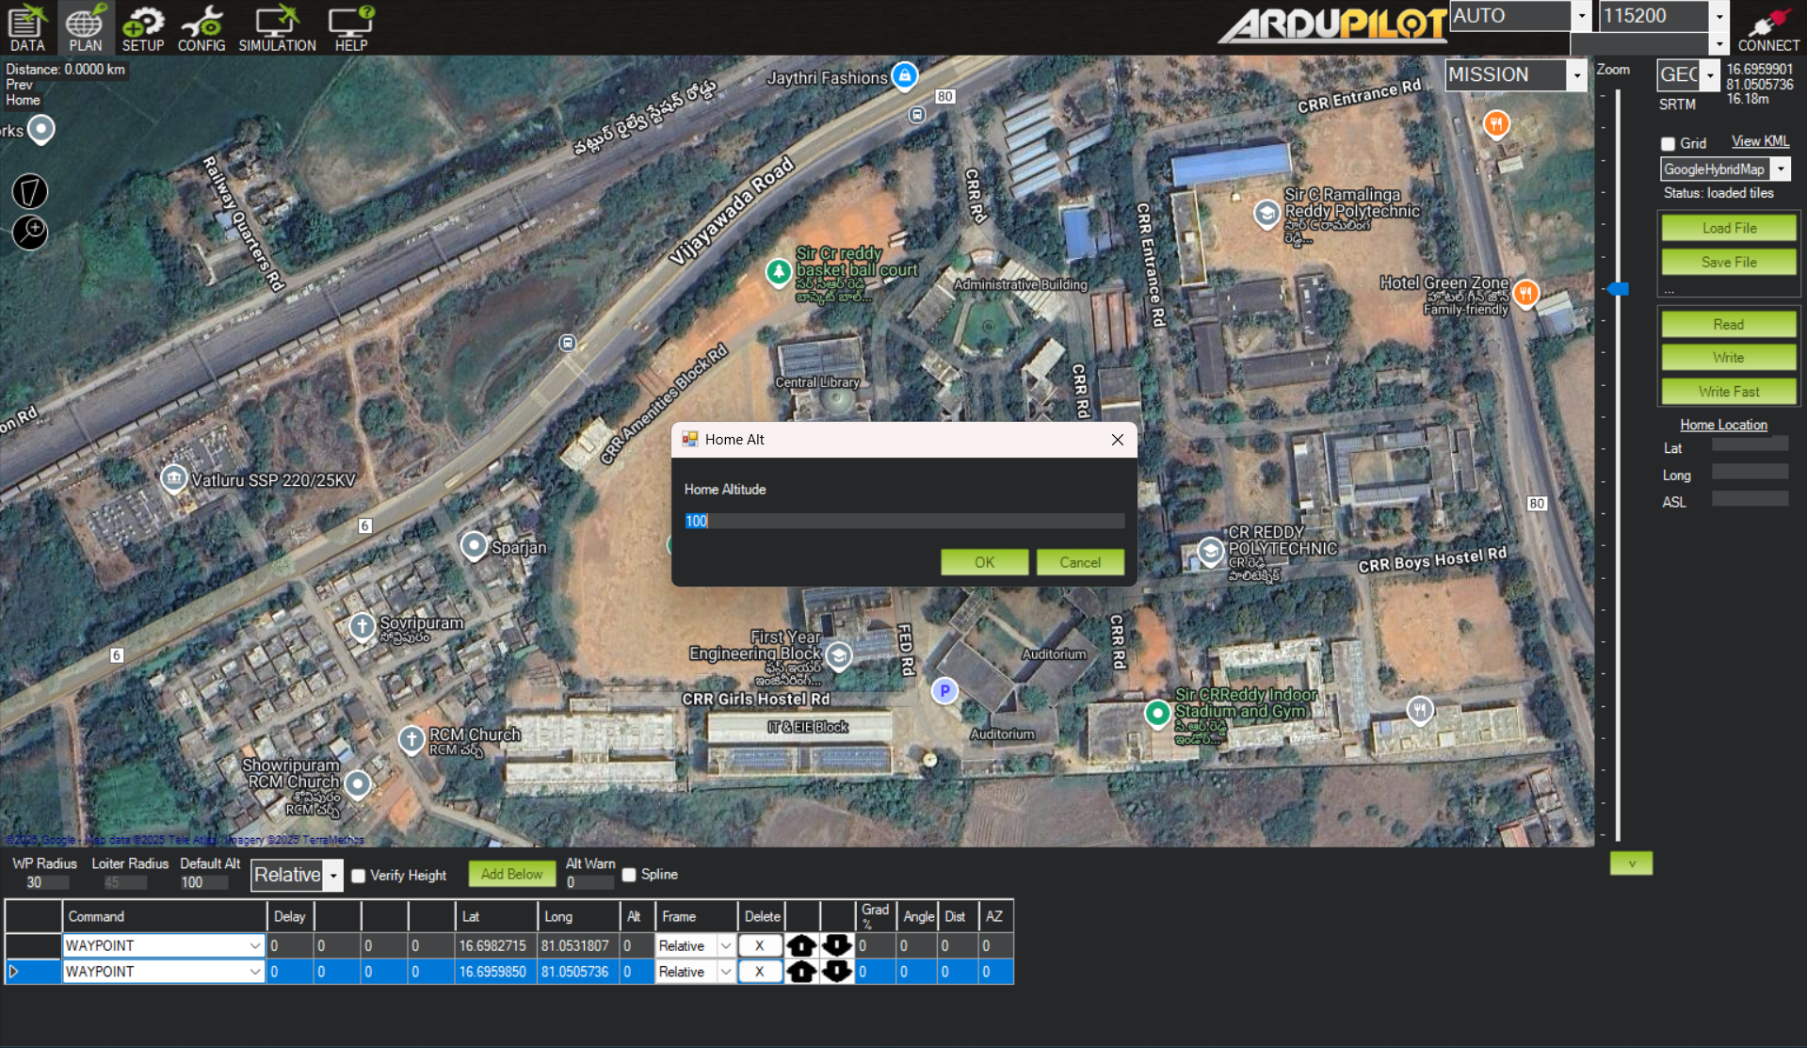
SIMULATION RESULTS
Gathering The Map Data
Setting The Altitude To Fly

Slide 11
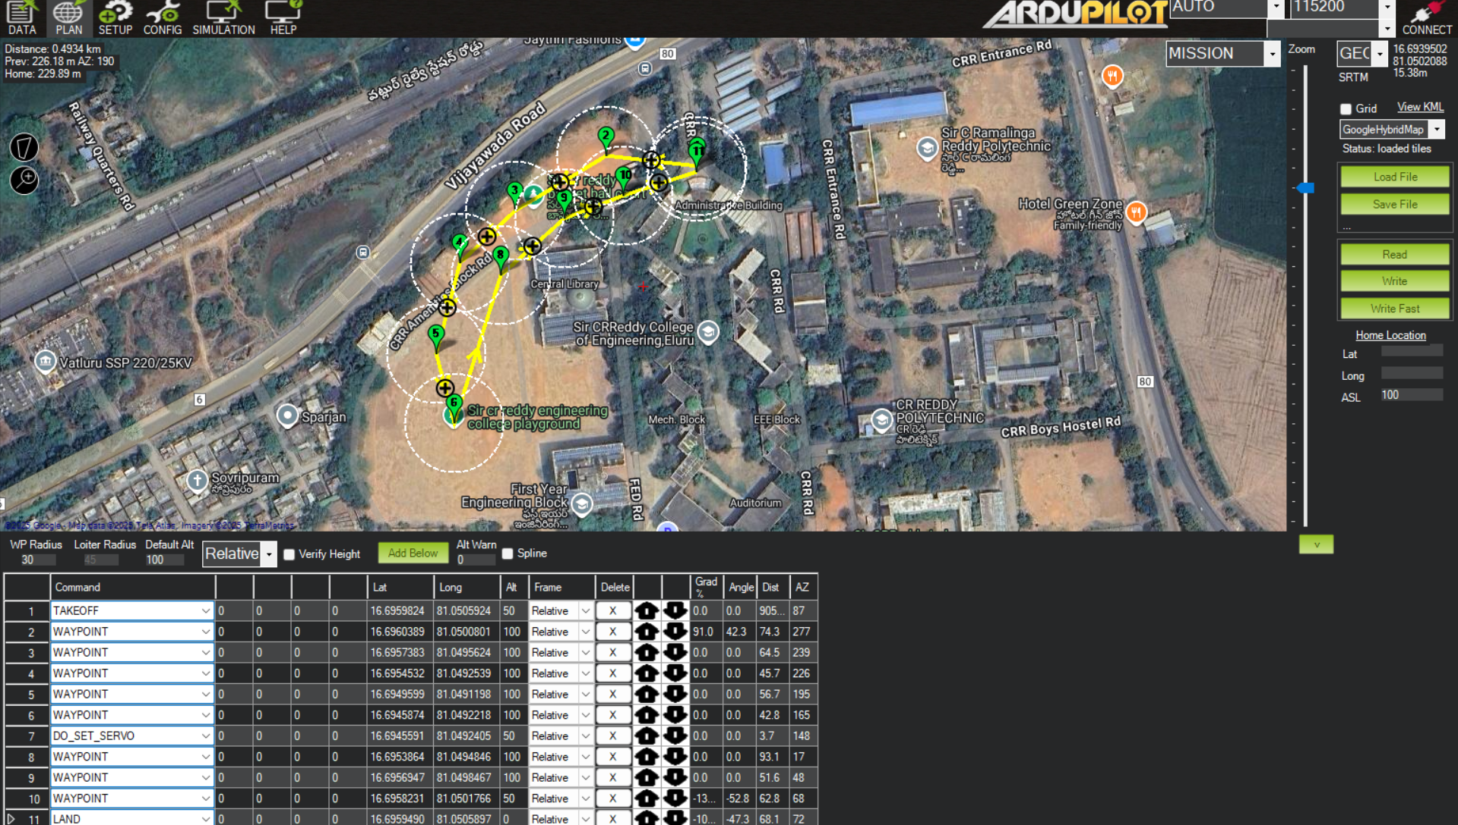
SIMULATION RESULTS
This image shows the drone’s flight path created in Mission Planner using set GPS waypoints.

Slide 12
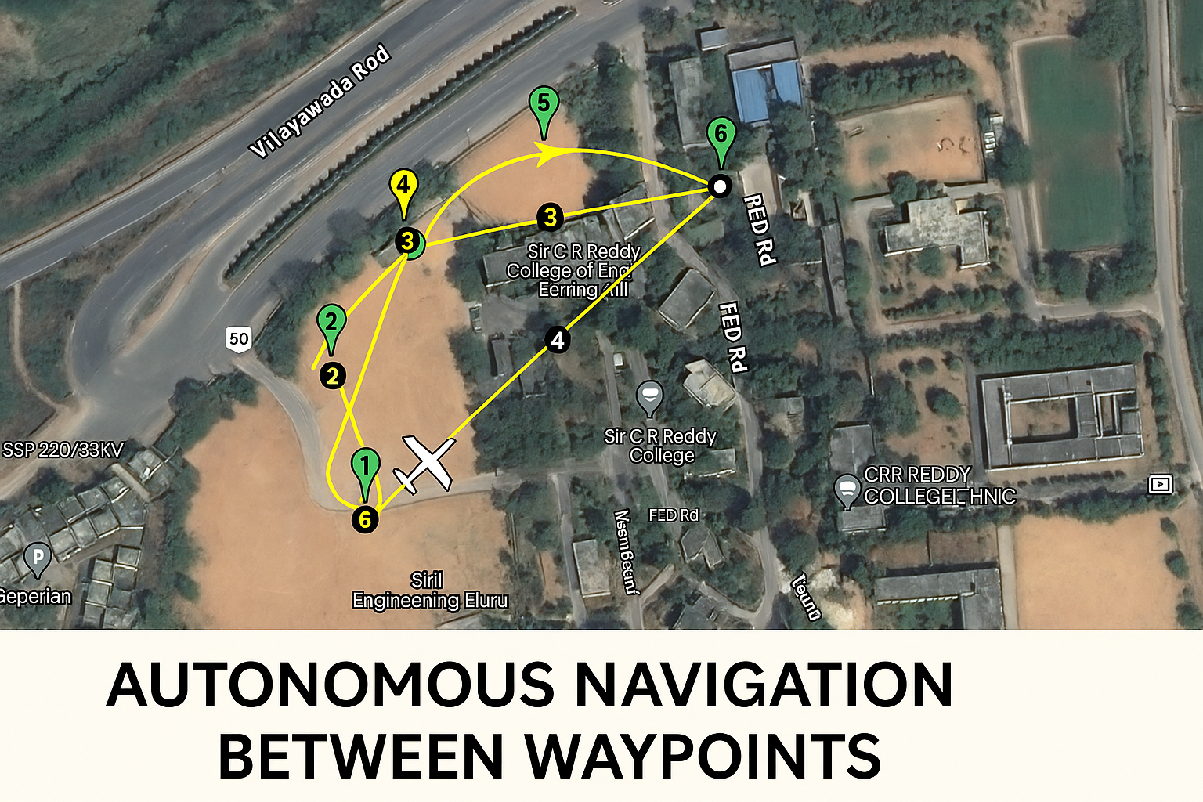
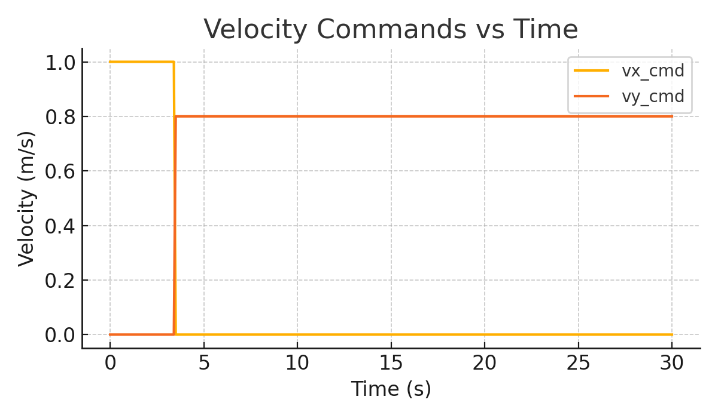

WORKING
Autonomous navigation between waypoints
This sheet shows the real-time telemetry data of the drone, including its time, position, altitude, velocity, and flight mode during the mission.

Slide 13
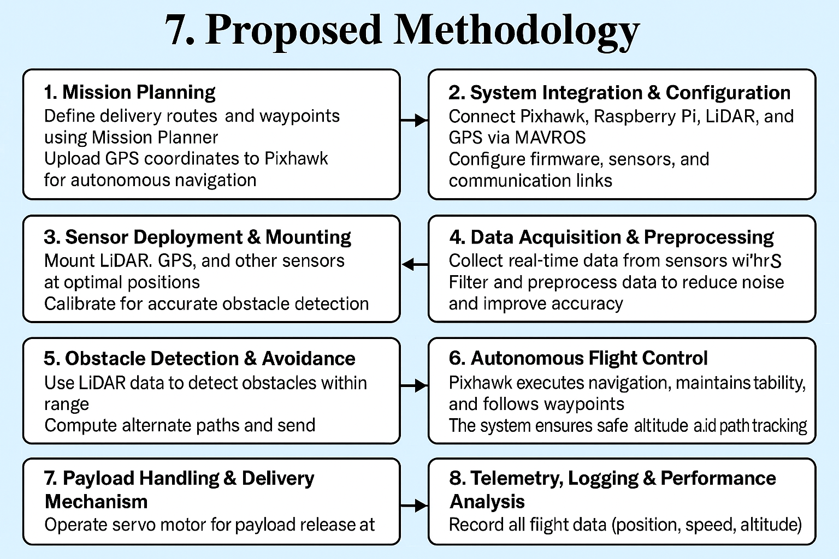
PROPOSED METHODOLOGY

Slide 14
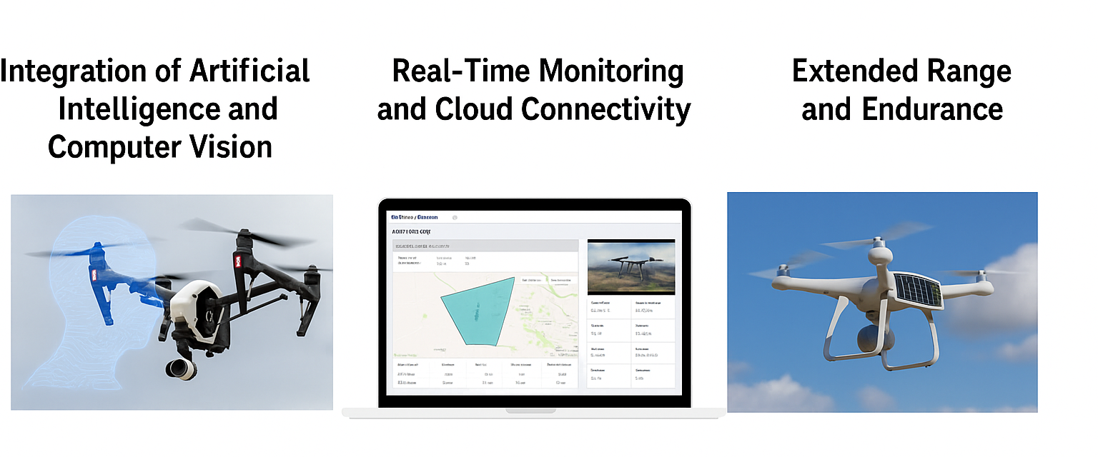
FUTURE SCOPE

Slide 15
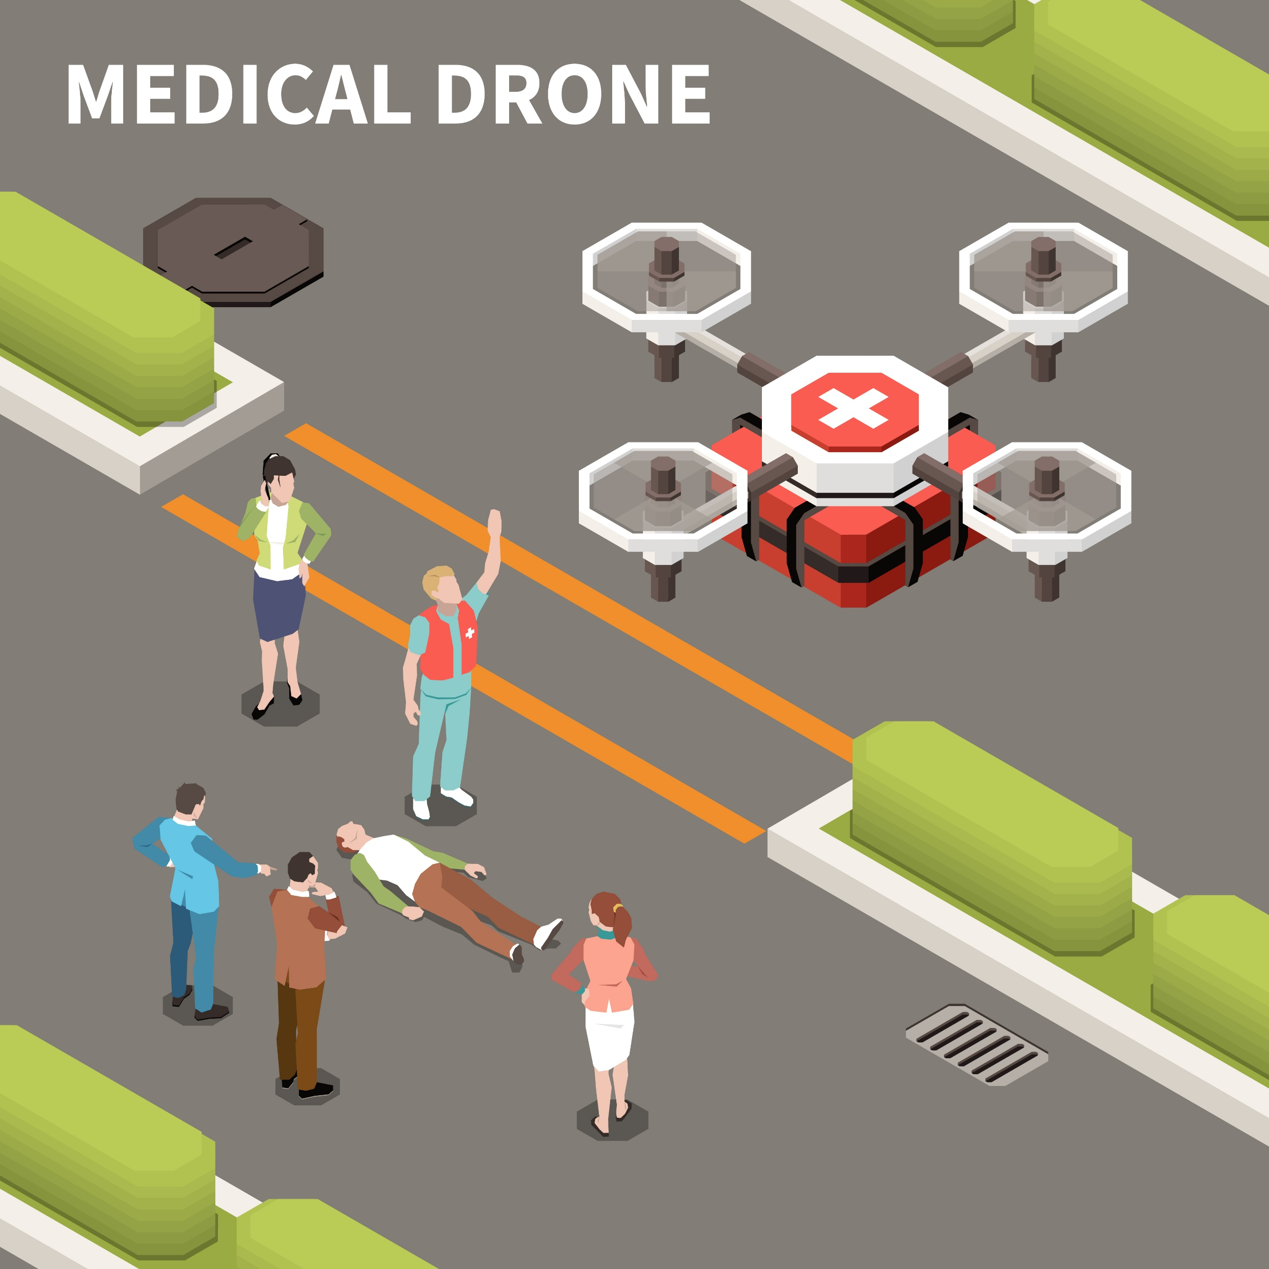
ADVANTAGES
Improved Accessibility
Faster Delivery Times
Versatile Operation
Reduced Human Contact
Enhanced Safety and Reliability
Environmentally Friendly

Slide 16
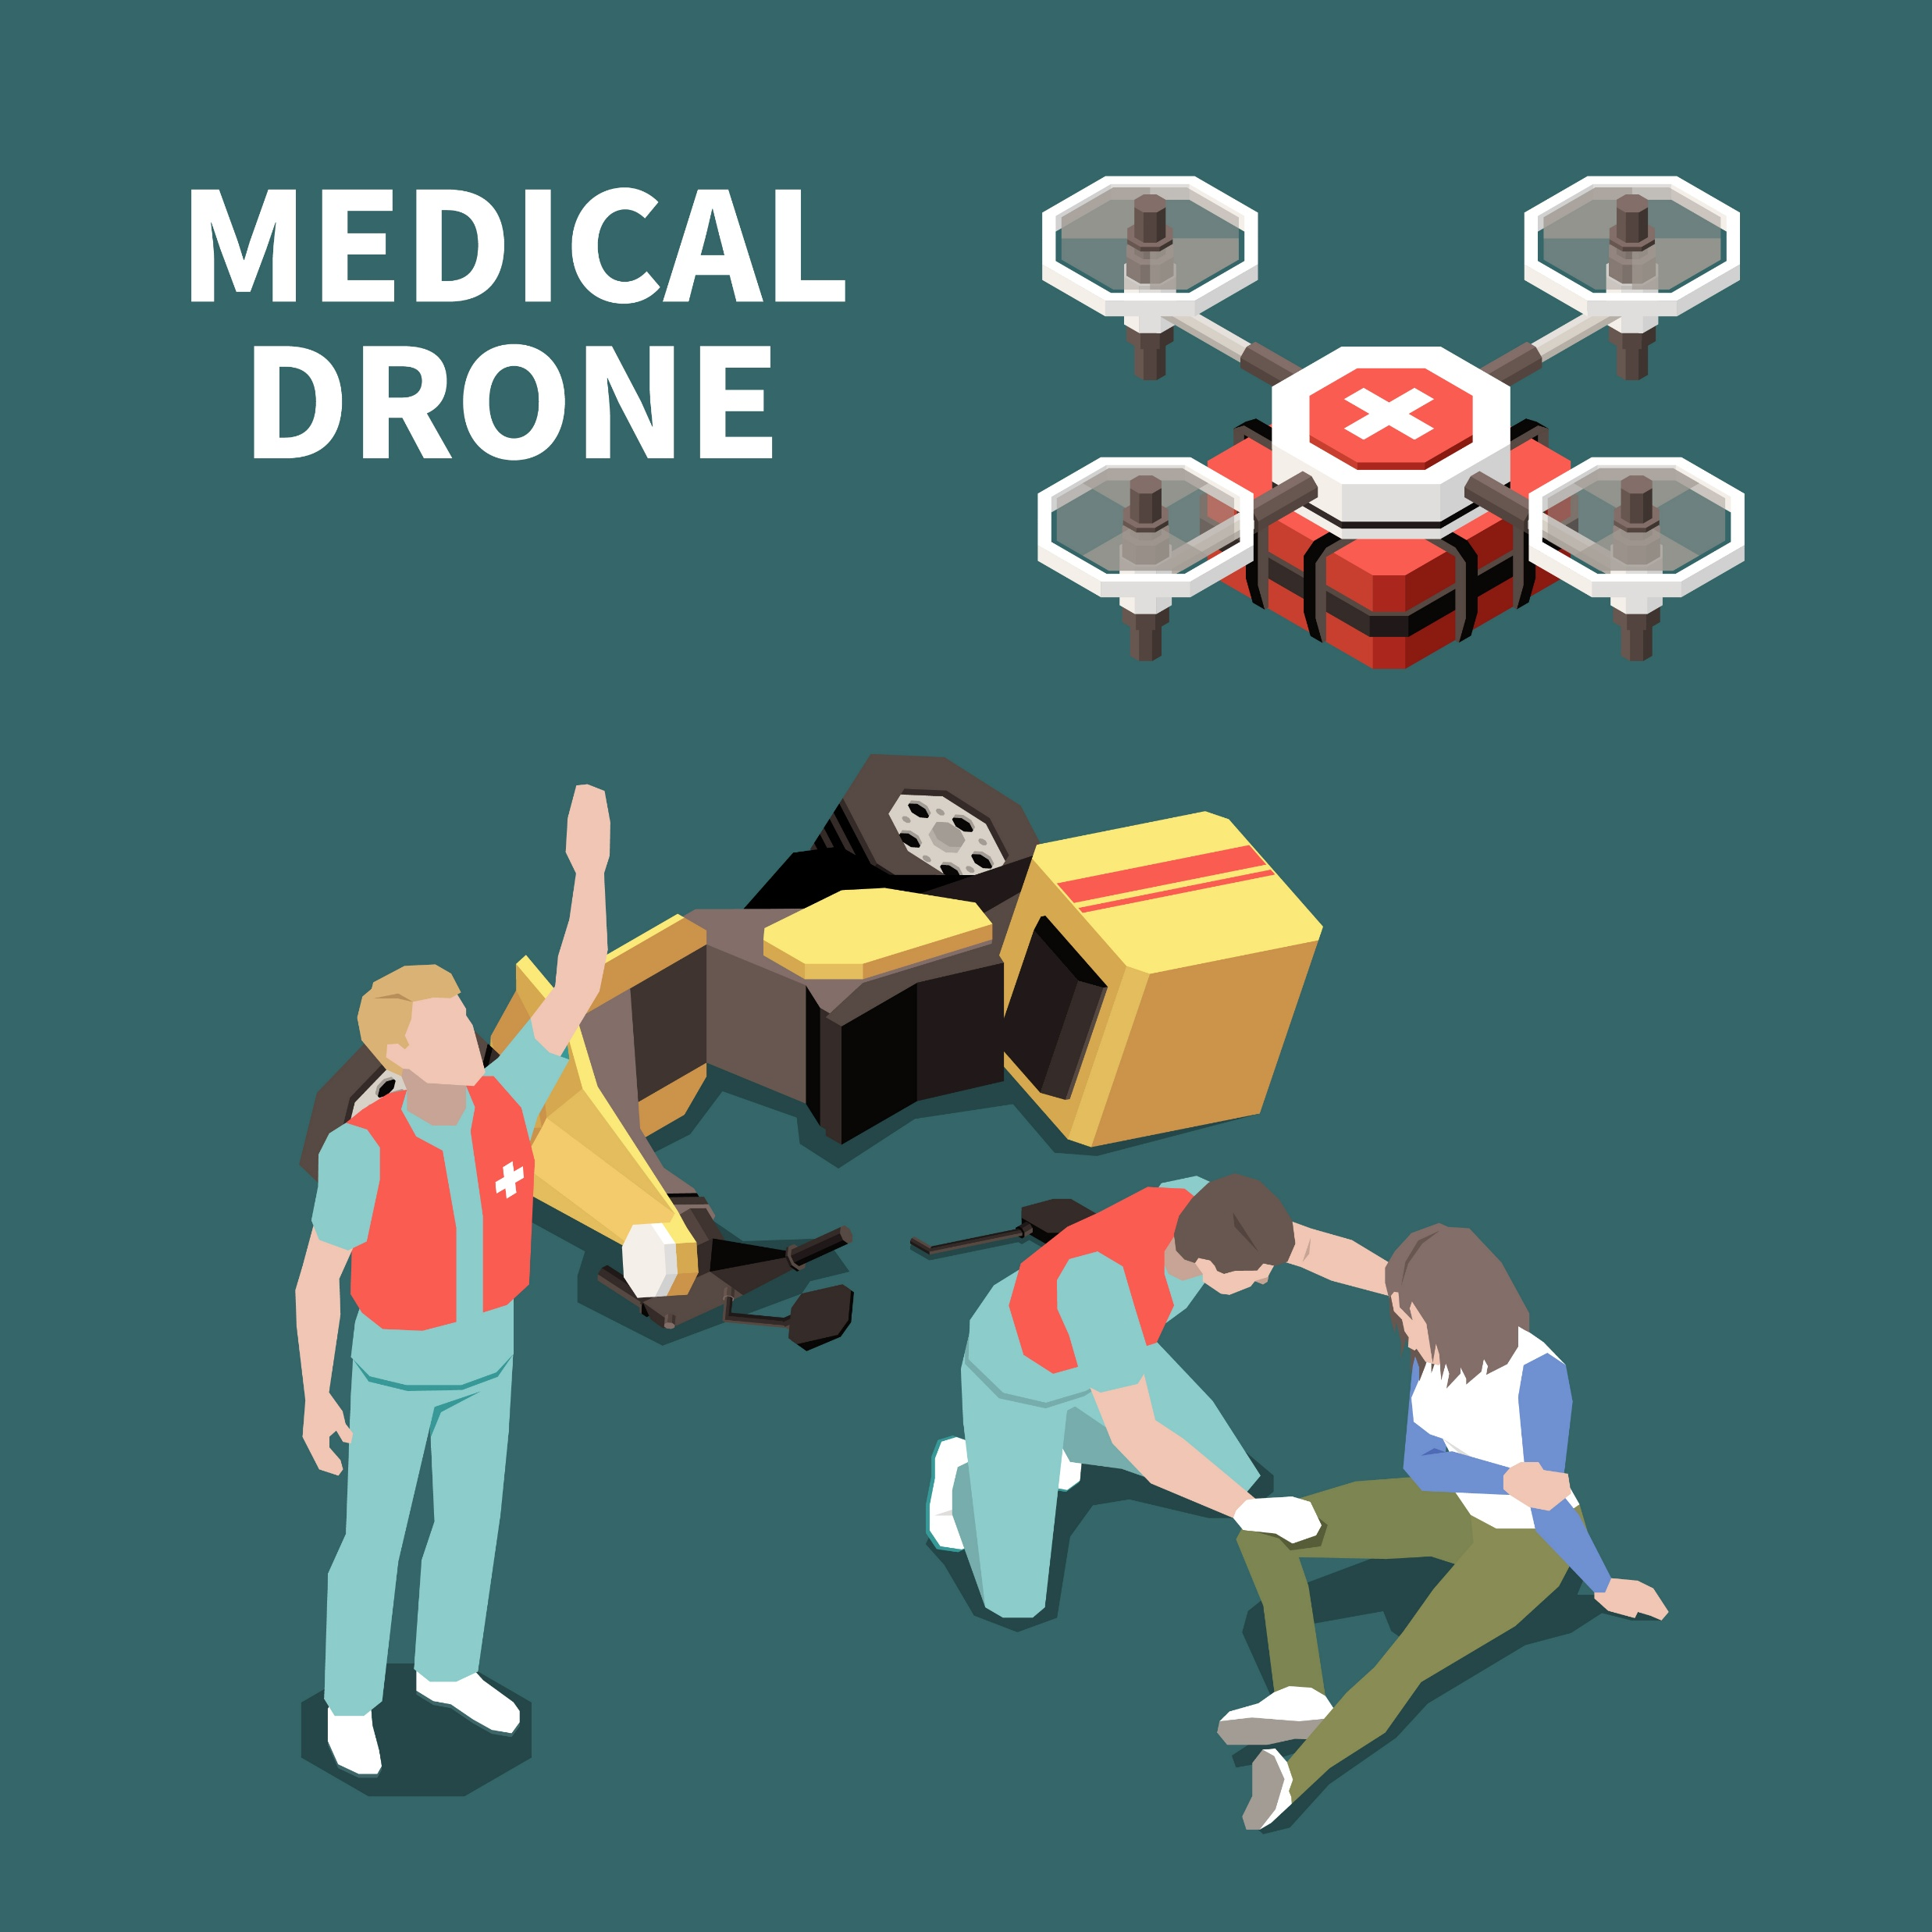
APPLICATIONS
Remote Medical Supply Delivery
Emergency Response
Healthcare Facilities Support
Pandemic Situations
Blood and Organ Transport
Vaccination Campaigns
Supply of Essentials
Disaster Relief Operations

Slide 17
REFERENCES
Konert, A., Smereka, J., & Szarpak, Ł. (2019). The Use of Drones in Emergency Medicine: Practical and Legal Aspects. Emergency Medicine International, 2019. https://doi.org/10.1155/2019/3589792
Nyaaba, A., & Ayamga, M. (2021). Intricacies of medical drones in healthcare delivery: Implications for Africa. Technology in Society, 66, 101624. https://doi.org/10.1016/j.techsoc.2021.101624
Jain, P. (2020). Medicine Delivery Drone. International Journal of Engineering Research and Technology, V9.
Dejene, B., Workeneh, B., Fekadu, E., Tadege, L., & Abdulwase, M. (2022). Medical Delivery Drone. International Research Journal of Engineering IT & Scientific Research, 4.
Gunarathna, J., & Munasinghe, R. (2018). Development of a Quad-rotor Fixed-wing Hybrid Unmanned Aerial Vehicle (UAV). IEEE MERCon. https://doi.org/10.1109/MERCon.2018.8421941
Ostojic, G., Stankovski, S., Tejic, B., Đukić, N., & Tegeltija, S. (2015). Design, Control and Application of Quadcopter. International Journal of Industrial Engineering and Management, 6, 43-48. https://doi.org/10.24867/IJIEM-2015-1-106
Kumar, R., Manoj, S., & Abinash Nataraj, S. (2020). Development of Drones for Delivery of Essential Medicines in Hilly Areas.

